Slide 1
Embedded Linux Fall 2013 Danielle Bolan

Slide 2
Project
Implement a node.js/SQLite web application on Rpi
Create a responsive web application on the RPi that can poll the current data
Display historical information on the data.
supply data to the RPi for feeding to the web

Slide 3
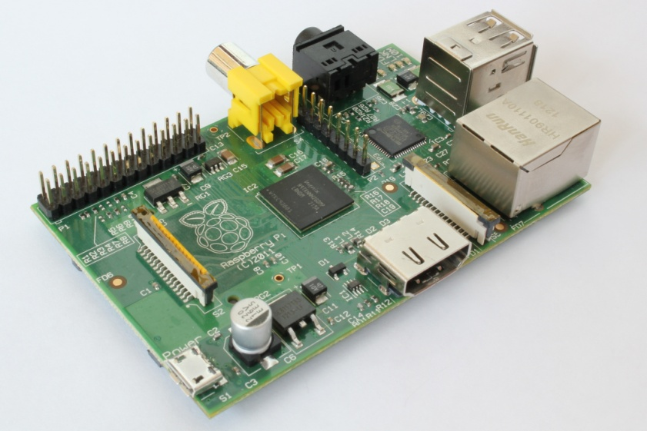
Hardware
Raspberry-Pi Model B

Slide 4



Software
Necessary Installations
Raspbian
Node.js
SQLite3

Slide 5
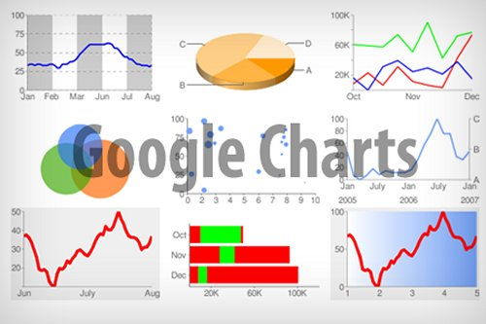
Display Data
Used Google Chart tools
Take data from database and display in graph form

Slide 6
Problems/ Lessons Learned
Database
Writing scripts
Laptop and Rpi
Line graph
Command Line
Pi, SQLite, Node.js
troubleshooting

